Slide 1


Training For Head Start and Childcare Providers
Notes:
Introduction to CFK: Total Section Time:10 minutes
Introduce Yourselves
Share Cavity Free Kids Training Format:
The Cavity Free Kids (CFK) training appeals to all learning styles. We will TELL you some key points…then SHOW you an activity or lesson that you will use to teach those points to children or to parents. You will get involved in DOING . We want you to experience as much of the materials as possible in 90 minutes so that you will see how easy it will be to build CFK into your program.

Slide 2
Goals for Today
Understand what causes cavities and how to work with children and families to prevent them.
Understand and plan to easily incorporate CFK into your work with children and in your conversations with families
Have fun
Notes:
Share Training Goals:
Understand what causes cavities and how to work with children and families to prevent them.
Understand and plan to easily incorporate CFK into your work with children and in your conversations with families
Have fun

Slide 3
Preventative Dental Data for 9 WCI Counties
Becker & Clay
Children under 1 yr. olds
Avg 9.7%
Percentage of 1-2 yr. olds
Avg 39 %
Percentage of 3-5 yr. olds
Based on 2020 Medicaid Data
Notes:
Preventative Dental Data – visiting a dentist
Only Becker (1.1%) & Clay (0.7%) counties had children under 1 yr. old visit a dentist for preventative care
Avg 9.7 % 1-2 yr. olds
Highest = Clay 14.9%
Lowest = Traverse 4.7%
Avg 39% 3-5 yr olds
Highest = Grant 48.7%
Lowest = Clay 33.2 %

Slide 4

The Children Behind the Statistics
Notes:
Facilitate Icebreaker: 5 minutes
Lead Stand Up Sit Down Activity OR Choose Your Own Icebreaker
Let's look at the real children behind the statistics. Stand up to show the oral health issues you have seen in the children you have worked with.
Stand up if you:
Have seen children with cavities
Have seen the results of baby bottle tooth decay
Have seen children who have lost teeth too early and wondered why
Have seen children with many caps or crowns
Have heard kids describing tooth pain
Know of children who have had dental treatment under anesthesia
Have heard parents say "They are just baby teeth"
Know families who avoid taking their child to the dentist or do not follow up with treatment
Wish NONE of the kids in your classroom had to suffer from tooth decay.
(Continue)
You have described why oral health education is so important.
The good news is, tooth decay is almost 100% preventable.
It is much more efficient, cost effective, and healthy to PREVENT oral health problems than it is to treat them. And prevention starts with education. Cavity Free Kids is your resource
to teach children, their families, and their caregivers what they can do to keep their teeth healthy.

Slide 5
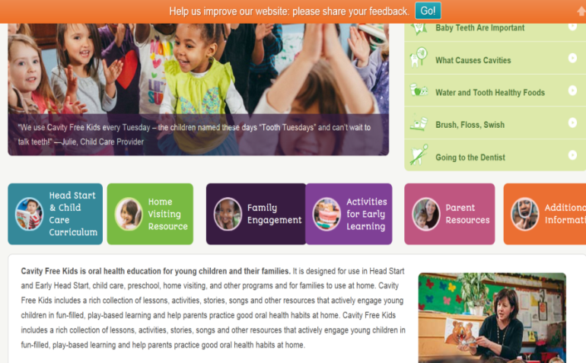
What is Included in Cavity Free Kids
The Cavity Free Kids curriculum includes:
flexible lessons, activities, stories, songs for children
resources to helps parents practice good oral health habits at home and connect to dental care
The CFK website: www.cavityfreekids.org
Notes:
Share What’s Included in CFK:
Between this training, this booklet (hold up) and the contents of the CFK website you will have everything you need to get started right away.
For preschool children there are lessons that include stories, songs and hands on activities that can be adapted to fit your classroom.
For infants and toddlers there are ways to begin oral health practices and to engage little ones with songs and activities
For parents there are resources that encourage them to practice good oral health habits at home and help connect them to dental care.
Share CFK Website Information:
You can find the entire curriculum on the website - cavityfreekids.org - plus more lessons, activities, and parent engagement resources. By registering and using the website, you can keep Cavity Free Kids alive in your classrooms long after this training.

Slide 6
The 5 Basics of Oral Health
Baby Teeth Are Important
Water for Thirst
Tooth Healthy Foods
Brush, Floss, Swish
Going to the Dentist
Notes:
Show how CFK is Organized:
CFK includes fun and easy lessons and activities you can adapt to fit your teaching style.
The oral health science is organized into 5 Basics of oral health. All of the lessons, activities, and parent resources are organized around these 5 Basics; the Basics are similar to units or sections.
Show how the CFK curriculum is organized:
Turn to Basic #1 – Baby Teeth are Important - on page 13 - to see what is included in each section. {point out the headings quickly}
Big Bites—these are big pieces of oral health information for your reference
Turn to page 14 CFK for Infants & Toddlers-messages and activities to do with little ones
Page 15 CFK Throughout the Day—ideas of ways to infuse your day with oral health messages (pause briefly to allow time to look at headings)
Page 16 Circle Time Introductory Lesson—to introduce the topic to the group
More Circle Time lessons—each section may have a different number of lessons for you. These go from page 17 to 22.
Page 23 -27 Learning Centers—activities to put out in the classroom to reinforce the group lesson
Beginning on Page 28 Parent Practice Handouts---to send the message home
Every section is laid out the same.

Slide 7
1
Basics of Oral Health:
Baby Teeth Are Important
Notes:
Use Sticky Notes to Identify Parts of CFK You’ll Use
As we go through the curriculum book, make notes or use sticky notes on the parts that you think you might like to try with your children.
At the end of the day you will have time to put your ideas into a plan.
Introduce Basic #1: Baby Teeth are Important - Total Section Time: 20 minutes
The first Basic is Baby Teeth are Important.
In this section children and parents will be learning what causes cavities and reasons to keep baby teeth healthy. This Basic emphasizes the importance of baby teeth in order to dispel the myth: “They’re just baby teeth; they’ll just fall out anyway”.

Slide 8
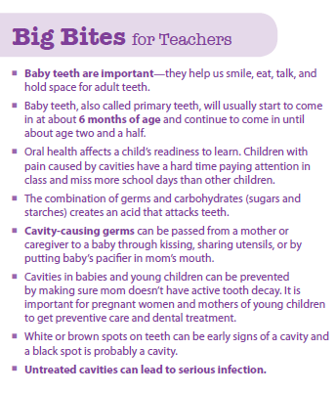
Big Bites: Baby Teeth Are Important
Notes:
Share Why Baby Teeth Are Important:
Turn to the page 13 titled “Big Bites”. The Big Bites are key oral health concepts children and parents need to know. If you have questions about the oral health information that you have learned today, the Big Bites will answer them.
The Big Bites highlight the concept that baby teeth help children smile and eat nutritious foods and play an important role in speech development.
The lips, tongues & teeth all work together to make the sounds that make words. When children have missing or painful teeth they may use their lips or tongues to protect those tender teeth & develop speech problems. Other reasons baby teeth are so important are that they shape the face as the child grows and hold space for the permanent teeth. Also, learning how to care for a child’s baby teeth helps establish good oral health habits & increases the likelihood of having a healthy mouth later in life.
Demonstrate Circle Time Lesson on page 18:
The Circle Time Lesson on Page 18 shows children how teeth help us talk
Say the sound “SSS” with me. Did you feel the air squeeze between your teeth? Now try it without using your teeth. It doesn’t sound the same, does it?
See how hard it would be to talk without teeth?

Slide 9
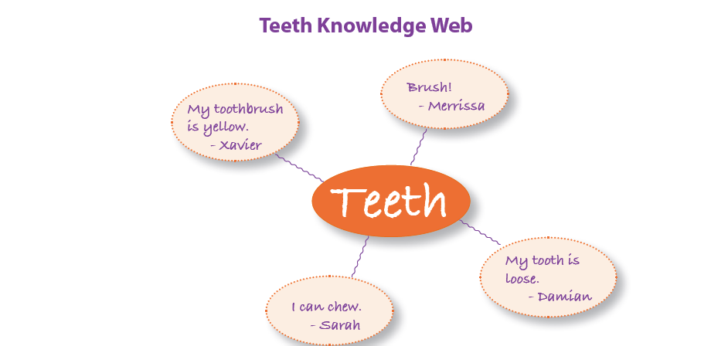
Circle Time: Teeth Knowledge Web
Notes:
Show how Circle Time lessons are organized:
Turn to the Circle Time lesson on page 16 and review how Circle Times are laid out.
Each oral health basic has a Circle Time lesson to introduce the concept. CFK is flexible - start with the Introductory Lesson or with another Circle Time.
All Circle Time lessons include icons that indicate whether the lesson includes a story, song, play, or other activity. There are instructions about how to lead the lesson. Stories or puppet plays include scripts.
The orange shaded box lists the supplies you’ll need.
As children are learning about their teeth they are working on their Head Start/preschool learning goals. Across the bottom the learning domains that are addressed are listed.
In Basic #1 there are 5 more Circle Time lessons, including songs and puppet plays and flannel stories.
You don't need to do any of the Basics in the order written--you can skip around and make them align with your class’ needs or themes. For example, you could deliver a lesson from Unit 5 about tooth brushing when you begin tooth brushing in your class. Or you might want to do a lesson about going to the dentist if you have a child who has his first appointment.
Practice the Teeth Knowledge Web in Groups of 4: 10 minutes
Working in groups of 4, pick one person to be the teacher and the other to be preschool children.
Read the instructions then have the teacher use the props to lead your class through the web activity.
When you hear the shaker, stop. One group will report out.
Report out/discussion:
Have one group share their knowledge web.
How did it go? (audience)
You can be as flexible and creative as you want to make it fit the ages or personality or learning needs of your particular class.
How could you add to this activity if your class was full of 5’s getting ready to go off to kindergarten?
How might you change this activity to make it work with a group of squirrelly 3 year olds?

Slide 10






Learning Centers
Notes:
Introduce Learning Centers:
(Prepare samples of several Learning Center Activities. Depending on the size of the group and time allowed, hold up and show the supplies or place them around the room and ask small groups to engage in play before looking at the directions written in the book)
What do you know about how children learn best?(audience responses: play, hands on, modeling, trying, singing, repetition, etc.)
Each Oral Health Basic includes Learning Center activities designed for children to explore and experiment and have fun while they learn about their teeth.
There are games to play, sensory materials to investigate, dramatic play centers to pretend in, and art projects to make.
Show How Learning Center Activities are Organized:
Let's look at page 23 to see some examples in Basic #1.
This section includes 7 Learning Centers.
(Encourage them to play with materials at their tables for a few minutes OR continue to describe and show activities)
Each one has a little icon picture to show you what TYPE of activity it is. The first one has the icon showing Toys and Games. So on your game table or manipulatives area you might set up puzzles of smiling children like this one (show puzzle—or ask person to hold up puzzle and show the group)
Instructions for you are clearly laid out on the left under the title.
The shaded part has a list of supplies. Most supplies are standard preschool supplies…or you can raid your own kitchen or junk drawer.
Because learning never stops, each activity has a list of domain elements that can be addressed as kids engage.
Group Activity and Discussion:
Divide into 3 groups and assign one of the 3 Learning Center Activities to each group: Happy Faces, Self-Portrait and Animals Have Teeth, Too.
Have each group read the instructions and supplies list and answer the following questions.
1. How do you imagine setting up the Learning Centers in your class?
2. Would you need to adapt or extend the activity?
Have groups report out to the large group.

Slide 11
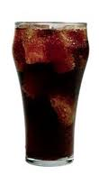
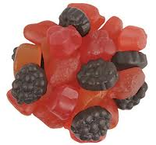
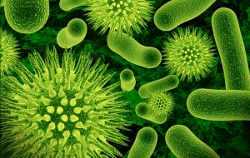
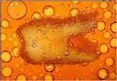
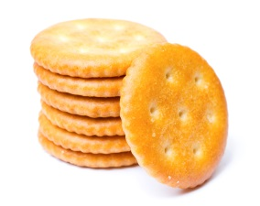
What Causes Cavities?
Germs + Food = Acid Attack
Notes:
(In advance, prepare a visual that you will relate back to each time you describe the factors that help prevent cavities—or use a white board or flip chart paper:
GERMS + FOOD = ACID --> CAVITIES)
Show What Causes Cavities by Demonstrating Learning Center Germs + Food = Cavities: 5 minutes
The Germs + Food Learning Center activity can be delivered with a small group of children or with parents at a Family Night.
This hands-on activity provides a visual demonstration of what causes cavities. I am going to engage some of you to help me, just like I would engage the children or parents. To see the directions, turn to page 26.
What did your parents tell you causes cavities? (responses may include cookies, sugar, sweets, not brushing,etc).
This equation - germs + food = acid attack is a simple way to remember the answer.
Imagine that this vase is a child’s mouth. For this demonstration pepper will represent the germs (Hold up vase that already has some pepper in it)
Did you know that the germs in our mouths—bacteria--can be spread from tooth to tooth & from person to person, usually from mother to child in the first 2 years of life?
If a mom has untreated cavities, she can spread cavity- germs to her baby by sharing everyday items... like utensils (Ask audience member to add a little pepper) or by taking a sip from baby’s sippy cup and then giving it to baby (Add pepper) or cleaning the pacifier in your own mouth. (Add pepper)
It’s not likely that moms will stop doing these things. That’s why it is VERY important that mom understands that she needs to have regular dental care during pregnancy. If she keeps her mouth healthy & cavity free she will be less likely to pass germs to her baby.
Germs alone don’t cause cavities. There needs to be food also. Germs thrive on sugary foods….things like cake, candy, ice cream & soda pop.(A different audience member puts in a little sugar)
Germs like foods that are easy for them to digest - not only do they like sugars, but that they also like refined carbohydrates – food whose main ingredient is white flour like pretzels, chips, crackers, and white bread (also called starches).
In this learning center, baking soda represents food. (Another audience member puts in a little soda)

Slide 12
What do Acid Attacks do to Our Teeth?
Notes:
Demonstration: Germs + Food = Cavities - Continue
When we eat or drink sugary or starchy foods & beverages, the germs eat them too. They use these foods to grow and make more germs then get rid of the rest as a waste product called acid. (Add vinegar to vase)
This acid flows on the teeth for 20 minutes! We call this the “Acid Attack”. (Use animation on slide here)
Let’s imagine that this is a baby who goes to bed with a bottle of milk or formula and sips on the bottle to get to sleep and every time he wakes during the night. (Add more baking soda and vinegar to vase a couple times)
Each time baby drinks more milk, there are 20 minutes more acid.
When this scenario is repeated over & over again those baby teeth end up sitting in acid all night long...getting weaker and softer and more susceptible to decay.
This is how children get cavities. And the same thing happens to adult teeth when we constantly sip on sugary drinks like juices, lattes or soda or when we constantly eat or “graze” on crackers, cereal or other carbohydrates throughout the day.
When we eat regularly scheduled meals and snacks our saliva flows on our teeth and gives them time to rest and repair. This can strengthen or re-harden them.
UNDER “WE CAN PREVENT CAVITIES”
ADD: “REST AND REPAIR BETWEEN FOOD/DRINK”

Slide 13
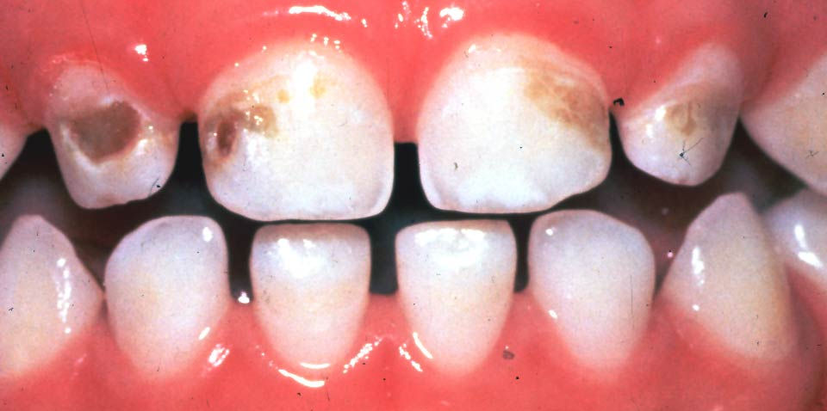
Early Childhood Caries
Cavities
White spots
Notes:
Show Examples of Tooth Decay:
Tooth decay is a progressive disease. Those weak/soft areas will continue to get worse if nothing is done.
Wait & see is NOT good advice when it comes to teeth. If decay is caught in the early stages it can be stopped or reversed.
On this photo you can see early stages of decay, such as the white spots & brown spots…and more advanced decay like the black spots.
When decay progresses to the center of the tooth, the pulp, infections called abscesses are common.

Slide 14
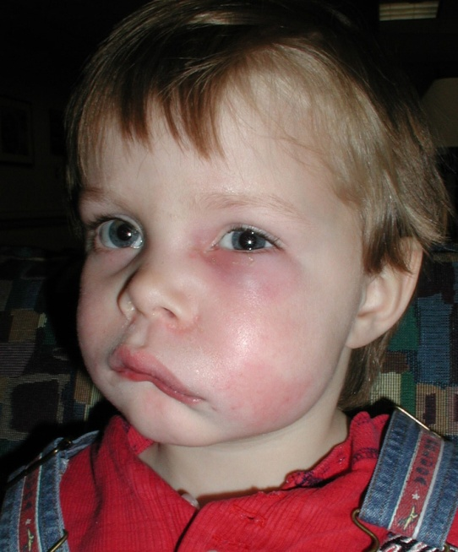
Abscess from Untreated Decay
Notes:
Show an Example of an Abscess and Describe What Action Should Be Taken:
This child has an abscessed tooth that has not been treated. The infection has caused swelling of his face that is beginning to spread up to his eye. It will continue to spread to other parts of his body unless treatment is started immediately, within 24 hours.
Children & adults can become so sick from this type of infection they can die.
Pair Share and Report Out:
Now that you have heard the basic oral health messages, turn to your neighbor and discuss these questions—What was new to you? What did you learn? What surprised you? In 5 minutes come back and be prepared to share with the group.
(Call on one or two)

Slide 15
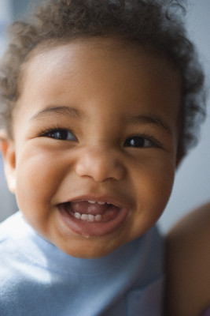
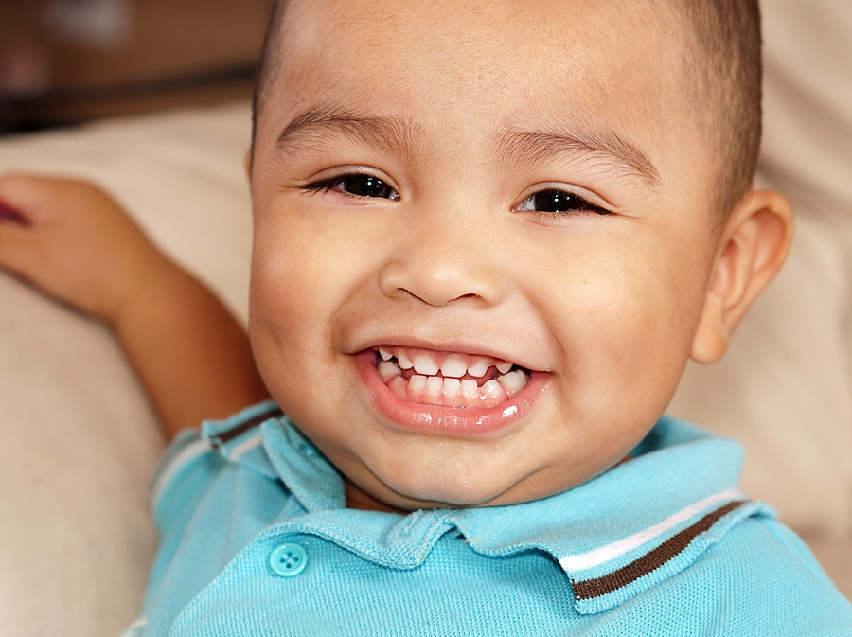
CFK for Infants and Toddlers
Notes:
For Programs with Infants and Toddlers
Highlight CFK for Infants and Toddlers:
Each of the 5 basics includes a section titled “CFK for Infants & Toddlers”. It is located right after the Big Bites.
CFK for infants and toddlers is designed to:
1) integrate oral health concepts and practices into infant/toddler classroom routines;
2) share oral health information with families so they can practice good oral health habits at home; and
3) introduce oral health concepts to children at an early age.
Turn to page 14 to see ideas for CFK for Infants and Toddlers. You can see under the heading “Daily Routines” there are things to do while diapering, mealtime, and playing.
Under Activities look at the first bullet and see how you can use Contact paper with the sticky side up to start talking about the concept of sticky foods, or “tooth unhealthy foods”. (pass around contact paper)
Write down two ways you can incorporate CFK into infant/toddler classrooms? (ask two people who work with infants/toddlers to share)
Many of the activities for big kids can be adapted for infants/toddlers. The Circle Time Lessons and Learning Centers that are appropriate for infants/toddlers have a Infant and Toddler Icon next to them.

Slide 16
2
Basics of Oral Health:
Water for Thirst
Notes:
Introduce Basic #2: Water for Thirst -Total Section Time: 10 minutes
WRITE “WATER FIRST FOR THIRST”
Basic #2 is Water First for Thirst.
One of the reasons decay rates are increasing is because of all the sweetened drinks people sip on throughout the day.
Rather than sipping on sugary beverages why not choose the one drink that is not only healthy for your body but is great for your teeth too - water! It comes right out of your tap at home.
In many communities, tap water has fluoride which helps strengthen the teeth & make them more resistant to cavities.
Remember - drink WATER FIRST FOR THIRST. Save juice & soda for special occasions.
(Note: Some families may have grown up in places where tap water is not safe to drink, remind them that it is safe to drink water in the United States.)

Slide 17
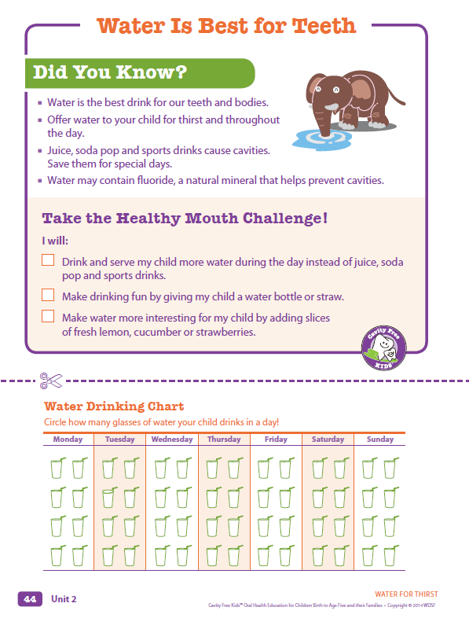
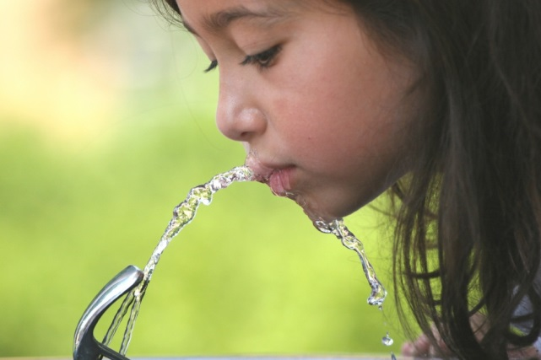
Parent Practice Handout
Notes:
Show/Explain the Purpose of Parent Practice Handouts:
Children do not control many of the decisions about their health, so it is critical to reach parents.
Take a minute to look at the Parent Practice Handouts in this section on page 44. They offer information for parents and then they encourage parents to interact with their children by either talking or doing things together.
They reinforce what you’re doing in your classrooms; share them with parents on days you’re using CFK in your classroom.
Each page has a Healthy Mouth Challenge. Families can make a commitment to healthy teeth by choosing one of the options to try. This one challenges parents to serve water instead of sugary drinks. This handout includes a chart families can cut out and hang up at home.

Slide 18
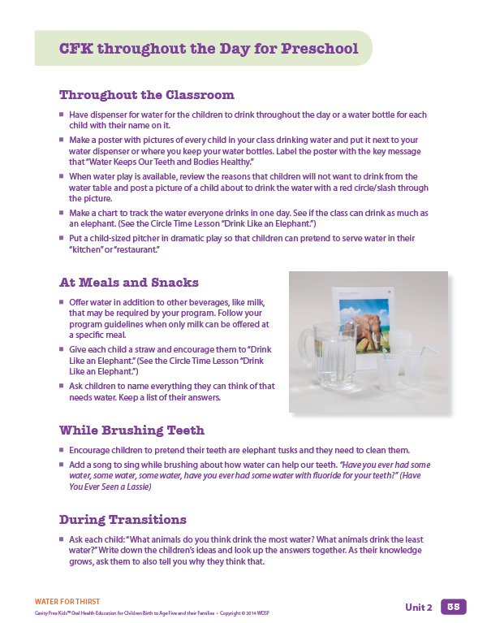
CFK Throughout the Day
Notes:
Discuss How to Promote CFK Throughout the Day in Classroom Practices, Routines:
Let’s talk about how to embed CFK in your classroom practices and routines.
The biggest impact happens when the environment supports oral health. There are many times during the day that CFK messages can be woven in to other topics and embedded into daily routines.
Each Oral Health Basic gives you some ideas called "CFK Throughout the Day.“
Demonstrate incorporating a CFK song into Transitions:
How about excusing your kids from Circle Time to their next activity using a song about drinking water? Let’s pretend Circle Time is over. As I sing your name take a drink of water! (depending on the size and familiarity of the group, have water and cups at each table or demonstrate by pouring a glass of water for a few people in front).
[Child’s name] and [Child’s name] are drinking up the water,
drinking up the water, drinking up the water.
[Child’s name] and [Child’s name] are drinking up the water, gulp, gulp, gulp, gulp,
Ahhhhh!
Pair Share: Partners Develop a List of Ways to Promote Water in their Classrooms - 8 minutes
Work with a different partner (or small group) to develop a list of practical ideas that would work in a classroom to get kids drinking water instead of sugary beverages.
Ask groups to report back.

Slide 19
3
Basics of Oral Health:
Tooth Healthy Foods
Notes:
Introduce Basic #3: Tooth Healthy Foods -Total Section Time: 10 minutes
WRITE : “EAT TOOTH HEALTHY FOODS”
The food + germs = acid attack learning center demonstrated HOW OFTEN we eat increases our risk for decay .
WHAT WE EAT - Making tooth healthy food & beverage choices –
CAN SIGNIFICANTLY REDUCE the risk of developing cavities.

Slide 20
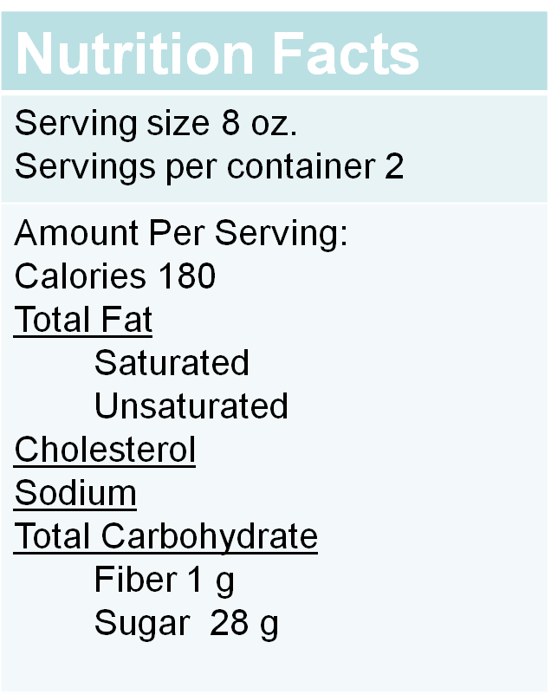
Parent Activity: Nutrition Facts Label
4 grams = 1 teaspoon
To calculate:
Find # grams of sugar
listed on label
Divide by 4
= # teaspoons of sugar
per serving
Notes:
Demonstrate Guess the Sugar in Drinks Parent Night Activity: 3 minutes
It’s not always easy to determine if foods are tooth “healthy” or “unhealthy”. One way to find out is by reading the nutrition facts labels located on most food items.
Let’s look at a chocolate milk label…(hold up a 16 ounce bottle of chocolate milk).
The first thing to find is the serving size. All of the information on this label is based on JUST ONE SERVING.
Since carbohydrates increase the risk for decay, look for the heading Total Carbohydrates. It lists fiber & sugar.
Note that foods with a high fiber content are better for your teeth because they are harder for the germs to break down & create acid attacks.
This label lists the sugars as 28 grams. Since it is hard to visualize a gram we will convert them into teaspoons.
To convert: take the # of grams and divide by 4
28 grams divided by 4 equals- 7 teaspoons of sugar. That’s 7 teaspoons of sugar in one serving. If you are going to drink the entire bottle, you need to multiply this number by the number of servings (in this case, 2). Ask audience for total teaspoons-
There are 14 teaspoons in this bottle of chocolate milk
Additional Information (if time permits or if participants have questions):
The American Heart Association recommends:
Adult males 9 teaspoons of sugar
Adult females 6 teaspoons of sugar
Kids age 4-8 3 teaspoons of sugar

Slide 21
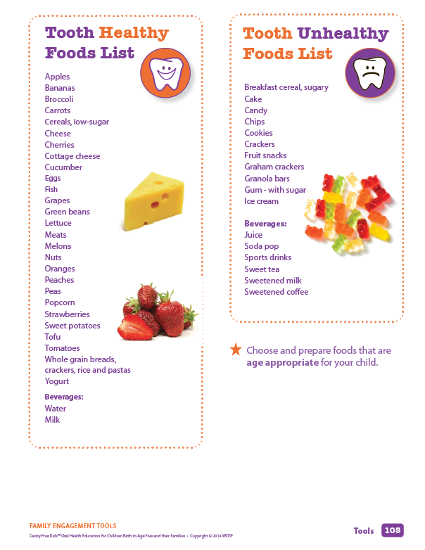
Tooth Healthy vs. Tooth Unhealthy
Notes:
If Time Permits
Demonstrate the Sugar Content in Some Foods: 5 minutes
A powerful activity is to guess the amount of sugar in a few common foods/drinks and then spoon that about into a container.
This activity is great for a family night. Directions for Parent Activities are located in the section titled Family Engagement. For each Basic Concept you will see Instructions for Activities, followed by Parent Handouts. The Parent Handout on the screen could be a good discussion starter. To find instructions for the sugar demo and a list of common foods go to page 103 in Family Engagement section.
Let's guess how much sugar is in: (go to audience and ask them to spoon in sugar; choose 2 or 3 that are pertinent to this audience)
LUCKY CHARMS cereal - 1 CUP=3.5 TSP
Granola Bar: Crunchy Low Fat 3 t.
JUICE- 1 CAPRI SUN HAS 6.5 – 7.5 TSP….TREETOP APPLE JUICE BOX=6.5 TSP (Make comments to emphasize sugar in juice and whole fruits as a better choice.)
It is unrealistic to ask people to give up sugary or carbohydrate foods completely. That’s why CFK encourages eating “tooth healthy” foods everyday & saving those “tooth Unhealthy” foods--the ones loaded with sugars & carbohydrates--for special occasions.
Choose Healthy Foods Activity:
(IF TIME PERMITS)
Another activity that can be adapted for both adults and children is to sort foods into (hold up bag) foods that are healthy to eat every day and (hold up other bag) foods we should save as treats for special occasions. There are a few examples of foods on your table. When I come to you, hold it for everyone to see then decide which bag to put it in. The directions for preschoolers are on page 48 .
(do in large group or small group depending on size of group)

Slide 22
4
Basics of Oral Health:
Brush, Floss, Swish
Notes:
WRITE “BRUSH, FLOSS SWISH”
Introduce Basic #4: Brush, Floss, Swish” – Total Section Time: 10 minutes
Basic #4 teaches children and families about brushing, flossing, and swishing.
Let’s look again at the vase from the acid attack demo (hold up vase with pepper/soda/vinegar)
Notice how the pepper (germs) has spread around the mouth (vase) and created a film on the sides of the vase?
This film is called plaque. We can get rid of plaque by brushing & flossing. (use small toothbrush to clean off a little bit of pepper)
It is recommended to brush twice a day - once after breakfast and again before bed.
Flossing removes plaque and debris that sticks between the teeth in places your brush can’t reach. Although flossing is NOT a school activity it needs to be encouraged and taught to children to help them develop the healthy lifetime habit.
Swish & swallow is great for times between brushings when you want to stop the acid attacks.
It should be used in ADDITION to brushing & flossing. It does not remove the germs but can help to wash away the food that is stuck on the teeth & stop acid attacks.
Take a gulp of water & vigorously swish it around the mouth…then swallow or spit it out. (Pour in a little water and swish it around vase)

Slide 23
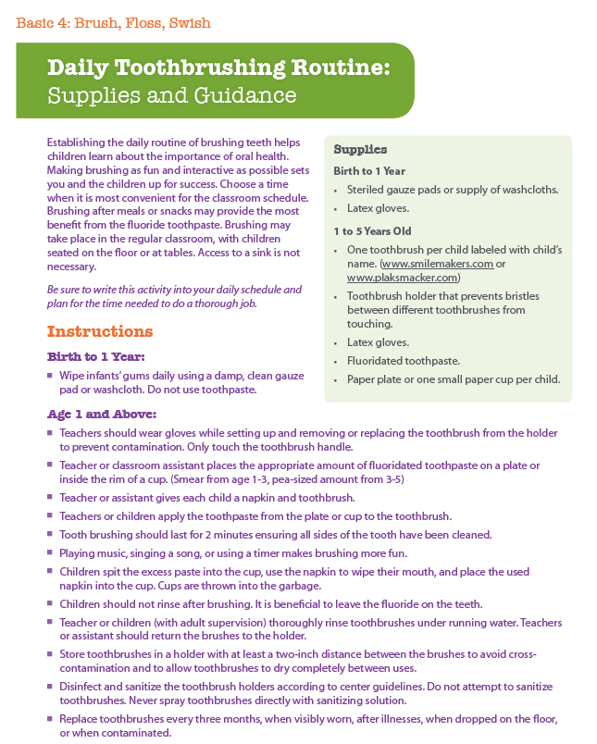
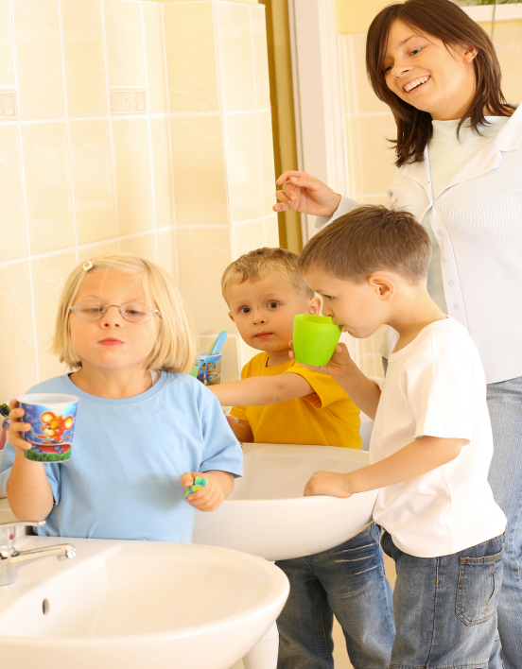
Toothbrushing Procedure
Notes:
For Programs Implementing Toothbrushing
Discuss Challenges and Opportunities:
(Assess needs of the audience by asking questions. Examples below)
Are your children brushing their teeth during the day? Are they excited and motivated to do it?
How is the process going for you? If you have any glitches or trouble spots, let’s brainstorm some ideas to help it go more smoothly (brainstorm).
How do you feel it is going for families at home? Do parents understand the importance of brushing? Are they making sure it gets done? How do you know?
For Programs Not Implementing Tooth Brushing or Expressing Difficulty
Demonstrate Setting Up A Tooth Brushing Procedure:
(Bring a sample of cup, toothpaste, napkin, toothbrush)
Teachers are sometimes reluctant to start brushing teeth. They have nightmares of lining kids up in the bathroom while they have sword fights with their toothbrushes.
On page 60, there is one tooth brushing procedure that is easy to implement and fun for children.
You don't need to use the bathroom. You don't even need to use a sink. You can do it when children are sitting at tables after they have eaten or with children sitting in a circle.
While the children are eating breakfast, I or my assistant teacher are setting up a little paper cup, with a pea sized dab of toothpaste, for each child. Setting it up this way prevents cross contamination.
Next to each child, I put a napkin, the little cup, and the toothbrush that has been labeled with his name.
Then children brush.

Slide 24
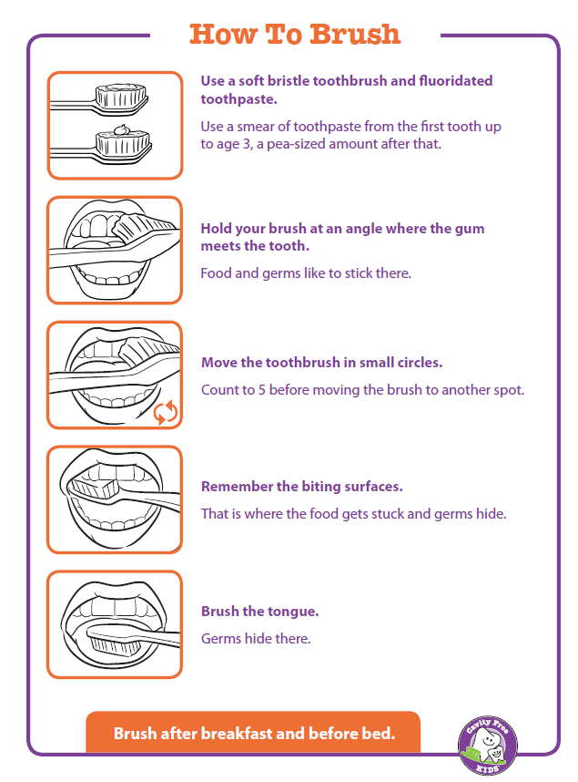
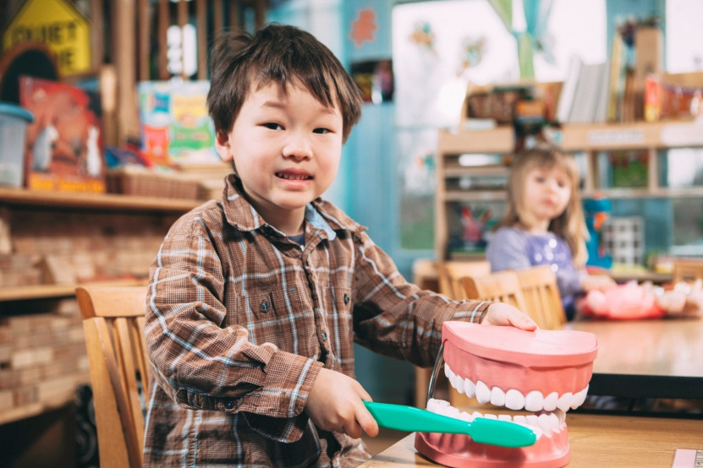
How to Brush
A smear when they appear and
at 3 the size of a pea!
Notes:
Discuss Parent Practice Handout:
This slide is of a parent practice handout that shows families how to brush.
Find it in the Family Engagement section on page 107.
You could send this home for parents to hang in their own bathrooms.
What other ways can you imagine using this page? (examples: hang poster at school, make a book, make a sequencing puzzle)
For Programs Not Implementing Toothbrushing:
Demonstrate Toothbrushing: 3 minutes
Brushing shouldn't seem like a chore! Making it fun and easy at when you start tooth brushing helps to set a positive tone and prevent whining and chaos.
On page 61, you’ll find a lesson that you can use to introduce tooth brushing in your classroom.
Brushing teeth at school is not as effective as individual brushing at home, but helps introduce and reinforce the habit.
Here is a fun way to get children excited about tooth brushing
Pretend you are children in my class:
- Are we ready to brush?
- Those cavity bugs are very ticklish! If we tickle them, they will go away! Let’s tickle them together! Touch your toothbrush to your teeth & make 5 itty, bitty, teeny tiny tickly circles on each tooth. Can you count with me? 1,2,3,4,5. Good! Now let’s move to the next tooth, 1,2,3,4,5. Fantastic! I can hear those cavity bugs saying, “Oh! I’m being tickled; I don’t want to stay in this mouth anymore”. Let’s keep tickling until we’ve tickled all the outsides of our teeth. Now, let’s tickle the insides. Don’t forget the bumpy places where you chew food! Continue to bottom teeth.
Those cavity bugs are trying to get out. Should we swallow them? NO! Let’s spit them out into our cup! Are we done brushing? No! We have to brush our tongue to get the rest of the germs so our breath isn’t stinky!
-Use your napkin to wipe your mouth then put it into the cup. Let’s throw those germs away into the garbage & rinse our brushes! Excellent job!!
You may find playing music, (like Raffi’s “Brush your Teeth”), using timers, or brushing with the children helps children get excited.

Slide 25
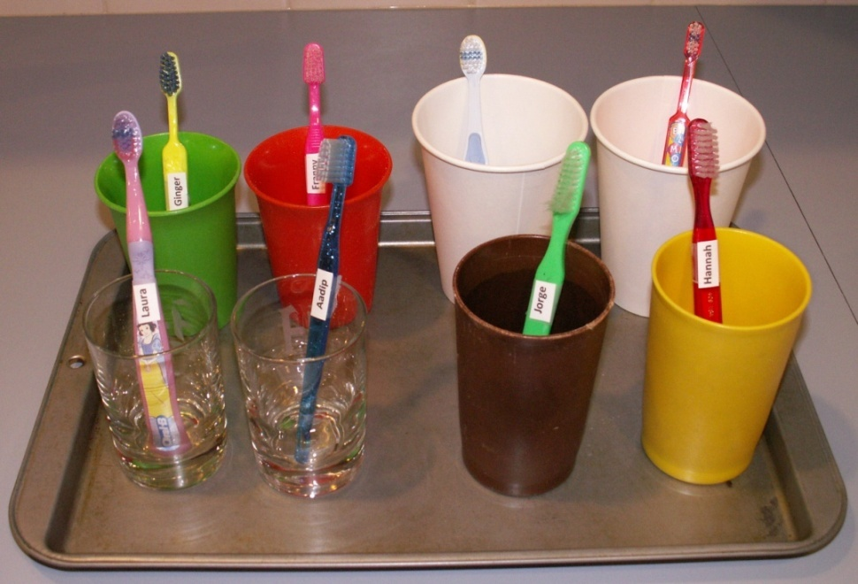
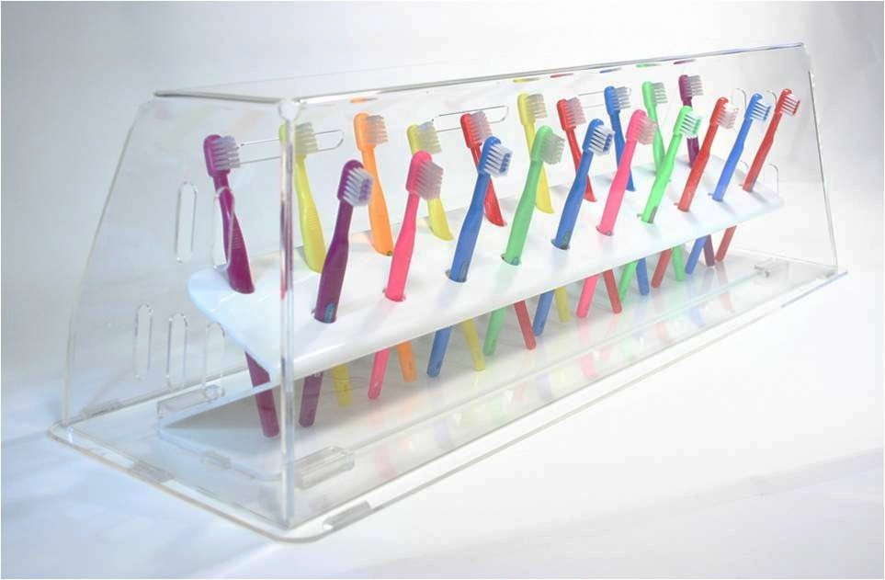
Toothbrush Storage
Notes:
For Programs Needing Guidance on Toothbrush Storage
Discuss Toothbrush Storage:
When everyone is done brushing, the adults collect the toothbrushes, rinse each in hot water and store them safely.
When storing brushes it is important that
- they are labeled
- the brushes do not touch each other
- they are left uncovered to air dry.
There are lots of options for storing toothpaste:
- Use a tray with individual cups to hold brushes. Label each brush/cup with the child’s name and can transport them to the toothbrushing area when needed.
Follow the protocol set by your organization - National Head Start or Washington State regulations.

Slide 26
Fluoride Helps Prevent Tooth Decay
Fluoride:
A natural mineral that helps prevent cavities
Fluoride Sources:
Tap water in many communities
Fluoride varnish, rinse, gel, toothpaste, drops and pills
Visit: www.ilikemyteeth.org
Notes:
Share Information about Fluoride:
Did you notice that children don’t rinse after brushing?
It is recommended that children spit but not rinse after brushing so that the fluoride in the toothpaste has more time to strengthen the teeth.
Be sure to follow center guidelines for the amount of paste to use or follow the general rule: a smear of toothpaste when teeth appear through age 3, and the size of a pea after that.
Since there are sometimes misconceptions about fluoride, we have included a Parent Practice Handout in your binder; share it with families or tell them to visit www.ilikemyteeth.org

Slide 27
5
Basics of Oral Health:
Going to the Dentist
Notes:
WRITE “SEE THE DENTIST”- Total Section Time 10 minutes
Introduce Basic #5: Going to the Dentist
Practicing healthy oral health habits in school and at home is important; it is also essential to have regular dental care.
Regular dental checkups are important for every child (& adult) because changes in teeth can happen quickly.
A dentist focuses on preventing and treating problems with the teeth and gums.
Every family should have a dentist that they visit regularly.

Slide 28
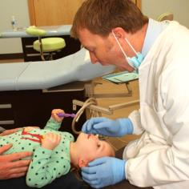
Visiting the Dentist
First Visit, First Birthday
Regular checkups – catch early decay and make teeth stronger (cleaning, fluoride varnish, x-rays)
Treatment – important to follow up
Notes:
Explain First Visit by First Birthday; Explain the First Visit:
It is recommended that children to have their “1st visit by the 1st birthday”. This may be at at a dental office or by a medical provider.
If a child has not had their 1st visit by their 1st birthday, encourage parents to get them in as soon as possible.
If families wait until age 3, decay could already be severe.
If tooth decay is found during the dental exam a follow-up appointment will be scheduled. It is important to encourage and support parents in scheduling these appointments. Putting off treatment can lead to more serious health issues.
Show Activities That Teach Children What to Expect at the Dentist:
As classroom teachers your role is not to connect families to the dentist; is to help children understand why w go to the dentist and to help prepare children for what they might expect when they get there.
Your classroom book has a variety of fun activities about visiting the dentist.
OR: Ask: What would you put in a pretend dentist office ? (do both if time permits)
Because your role is also to share with parents what their children are being taught, remember to send home the art activities and Parent Practice

Slide 29

Connecting Families to Care
Access to Baby and Childhood Dentistry (ABCD)
Private Insurance
Notes:
For Staff Assigned to Connect Families with Dental Care
Discuss Resources for Connecting Families with Dental Care:
It is often hard to get families to schedule & keep dental appointments.
Our goal is that every child will have a dental home. The good news is that in Washington state this can be a very real goal.
Every child who is Medicaid eligible can be connected to a dentist through the Access to Baby and Child Dentistry (ABCD) program. Have you heard of it? If so, what have you heard?
ABCD program will connect families with Medicaid eligible children 0 – 5 to a dentist in their area. ABCD dentists are trained to provide dental care to young children.
Children who are not on Medicaid may be insured privately. Encourage families to check their own dental plans and establish a dental home.
Additional :
If they ask, access for adult care is not as easy—children and pregnant women have become the current focus in our state. Refer them to WDSF’s website – it includes a list of FQHCs.

Slide 30
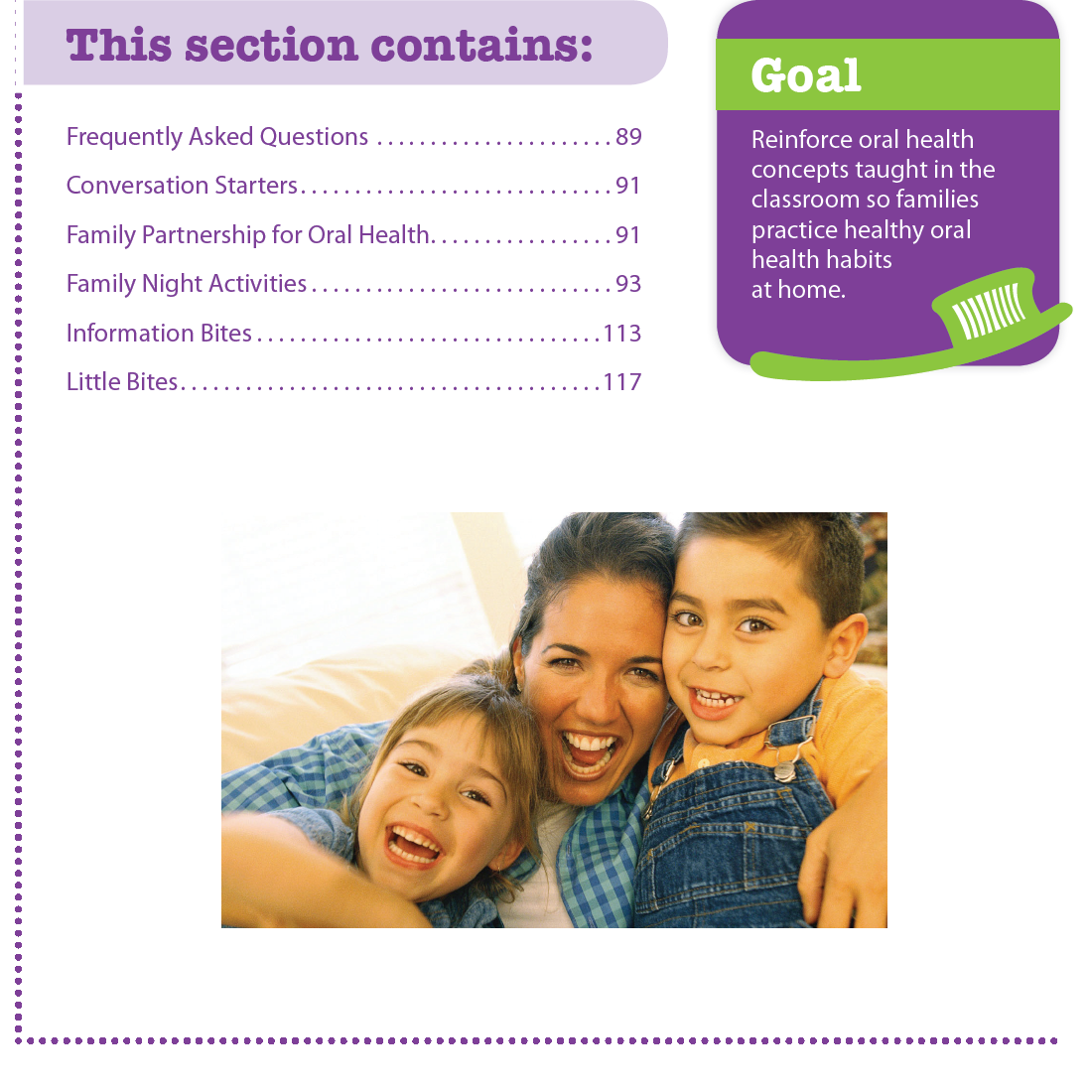
Family Engagement
Notes:
Review Family Engagement Tools:
In the back of your binder is a family engagement section (use the tab) with tools for you to use.
How about planning Family Nights? Or including CFK Activities at recruitment or health fairs or even literacy events? You will find some ideas here.
Let’s look at the section titled Family Engagement Tools.
Here you will find things to help you reach families:
Frequently Asked Questions for your reference,
Conversation Starters to help you bring up the subject of oral health,
Family Night Activities,
How do you communicate with parents? (Ask audience)
Newsletter? Website? Bulletin board? How about including a CFK corner?
The “Information Bites” are short messages ready for you to use and,
the “Little Bites” are additional parent practice handouts addressing the following topics: Teething, Lift the Lip, Fluoride, Sealants and Accidents.

Slide 31
Appendix
www.cavityfreekids.org
Notes:
Share What is Included in the Appendix:
Turn to the list of contents on page 123.
There is an early learning domain crosswalk which outlines how using CFK meets learning goals.
There are templates (master copies); use these to deliver lessons and activities.
There is a list of recommended books for children.
Share Website Information and Address:
The website includes more CFK lessons, activities, parent engagement tools, and other resources.
When you get home (or now, if appropriate) go to cavityfreekids.org to register to gain access to the website.

Slide 32
Commit to Oral Health
Requirements
Themes
CFK Day, Week, Month, Year
One Circle Time
Supportive Learning Centers
Notes:
Discuss Using CFK: - Total Section Time: 15 minutes
As you think about using CFK, you might think in terms of requirements, themes, and/or schedules.
Any of the Cavity Free Kids activities can fulfill your Health requirement. Many can be used to fulfill your Nutrition requirement.
Many CFK lessons and activities fit into themes you already address like animals, community helpers, or even transportation - you could set up a bus to take kids to the dentist.
Please decide how often you will fit oral health activities into your daily, monthly or yearly plans and schedules.
Most people we’ve worked with have incorporated CFK into daily routines and practices and taught lessons and/or organized learning centers about once a week; and
Shared information with parents (via notes, parent handouts) about once a month.
Plan Individually or in Pairs: 10 minutes
We would like you to work with your partner again to do some planning (change partners so working teams are together). Look through your book or use your sticky notes and decide how you will use Cavity Free Kids in your classroom. You will have 5 minutes to plan and then report back.
Here is your assignment:
Think about 2 themes you use in the classroom where you will incorporate oral health.
Decide how often you will use CFK activities.
Plan one CFK Day: Choose one circle time you will teach. Choose 2 learning center activities that you will set up in your classroom.
(Return and share) 5 minutes

Slide 33
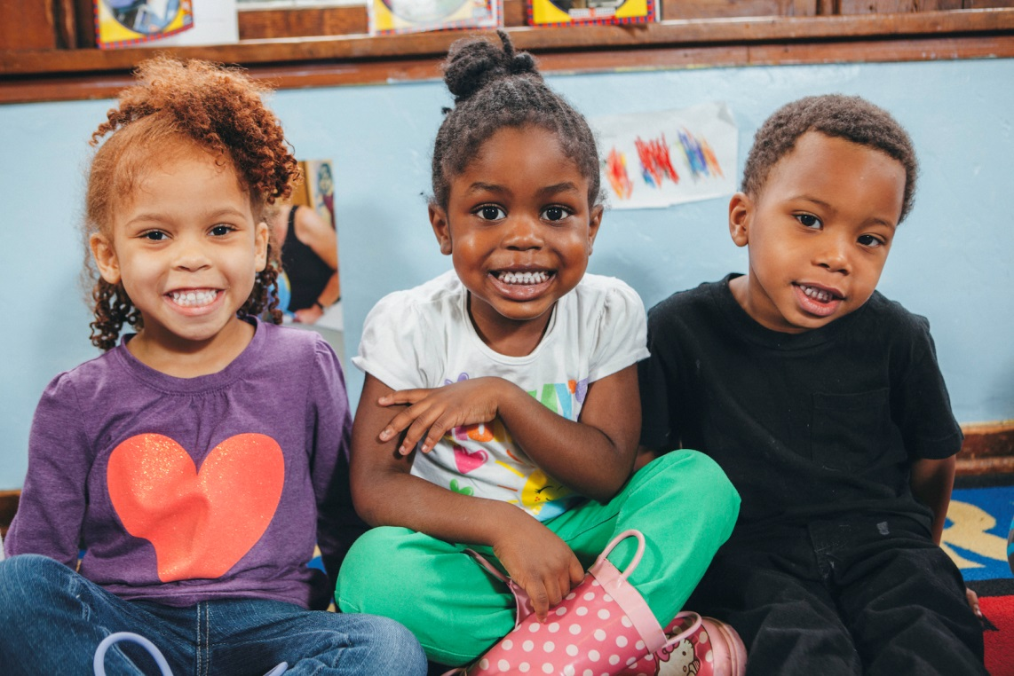
For a Lifetime of Good Oral Health
Notes:
Administer Quiz: 5 minutes
Let’s take a short quiz to check our oral health knowledge.
Raise your hand if you know the answer (Call on people randomly—ask for SHORT answers):
Name one tooth healthy drink. (water)
Which types of foods are tooth healthy? (protein, fruits, vegetables) Tooth unhealthy? (sugars, carbohydrates)
Name one way you can incorporate CFK into snack time.
What is one way you can communicate to parents the importance of oral health? (send home art, handouts, meetings)
What are some ways to make brushing more fun? (songs, timers)
Which is better for teeth: 100% apple juice or an apple? (apple)
Where can you find more CFK activities & information? (website)
Bonus: How many teaspoons in 16 grams of sugar? (16 divided by 4 = 4)
Close and Distribute Surveys:
You are now ready to become Cavity Free Kids Champions and to change the oral health of the families you serve.
Thank you for coming and participating. Any questions…comments?
Feedback forms

